Slide 1
INTERPROCESS COMMUNICATION
VFSTR

Slide 2
Topics
INTRODUCTION The API for the INTERNET PROTOCOLS EXTERNAL DATA REPRESENTATION CLIENT-SERVER COMMUNICATION GROUP COMMUNICATION
VFSTR
Couloris,Dollimore and Kindberg Distributed Systems: Concepts & Design Edn. 4 , Pearson Education 2005

Slide 3
Introduction
The java API for interprocess communication in the internet provides both datagram and stream communication. The two communication patterns that are most commonly used in distributed programs: Client-Server communication The request and reply messages provide the basis for remote method invocation (RMI) or remote procedure call (RPC).
VFSTR
Couloris,Dollimore and Kindberg Distributed Systems: Concepts & Design Edn. 4 , Pearson Education 2005

Slide 4
Introduction
Group communication The same message is sent to several processes.
VFSTR
Couloris,Dollimore and Kindberg Distributed Systems: Concepts & Design Edn. 4 , Pearson Education 2005

Slide 5
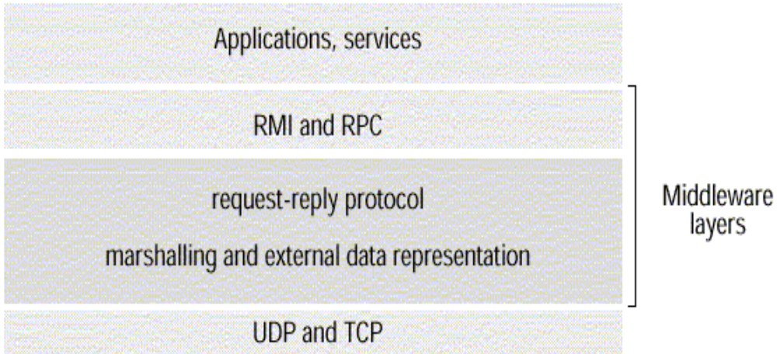
Introduction
This chapter is concerned with middleware.
Figure 1. Middleware layers
VFSTR
Couloris,Dollimore and Kindberg Distributed Systems: Concepts & Design Edn. 4 , Pearson Education 2005

Slide 6
Introduction
Remote Method Invocation (RMI) It allows an object to invoke a method in an object in a remote process. E.g. CORBA and Java RMI Remote Procedure Call (RPC) It allows a client to call a procedure in a remote server.
VFSTR
Couloris,Dollimore and Kindberg Distributed Systems: Concepts & Design Edn. 4 , Pearson Education 2005

Slide 7
Introduction
The application program interface (API) to UDP provides a message passing abstraction. Message passing is the simplest form of interprocess communication. API enables a sending process to transmit a single message to a receiving process. The independent packets containing theses messages are called datagrams. In the Java and UNIX APIs, the sender specifies the destination using a socket.
VFSTR
Couloris,Dollimore and Kindberg Distributed Systems: Concepts & Design Edn. 4 , Pearson Education 2005

Slide 8
Introduction
Socket is an indirect reference to a particular port used by the destination process at a destination computer. The application program interface (API) to TCP provides the abstraction of a two-way stream between pairs of processes. The information communicated consists of a stream of data items with no message boundaries.
VFSTR
Couloris,Dollimore and Kindberg Distributed Systems: Concepts & Design Edn. 4 , Pearson Education 2005

Slide 9
Introduction
Request-reply protocols are designed to support client-server communication in the form of either RMI or RPC. Group multicast protocols are designed to support group communication.
VFSTR
Couloris,Dollimore and Kindberg Distributed Systems: Concepts & Design Edn. 4 , Pearson Education 2005

Slide 10
Introduction
Group multicast is a form of interprocess communication in which one process in a group of processes transmits the same message to all members of the group.
VFSTR
Couloris,Dollimore and Kindberg Distributed Systems: Concepts & Design Edn. 4 , Pearson Education 2005

Slide 11
The API for the Internet Protocols
The CHARACTERISTICS of INTERPROCESS COMMUNICATION SOCKET UDP DATAGRAM COMMUNICATION TCP STREAM COMMUNICATION
VFSTR
Couloris,Dollimore and Kindberg Distributed Systems: Concepts & Design Edn. 4 , Pearson Education 2005

Slide 12
The Characteristics of Interprocess Communication
SYSTEM MODEL
Synchronous and asynchronous communication In the synchronous form, both send and receive are blocking operations. In the asynchronous form, the use of the send operation is non-blocking and the receive operation can have blocking and non-blocking variants.
VFSTR
Couloris,Dollimore and Kindberg Distributed Systems: Concepts & Design Edn. 4 , Pearson Education 2005

Slide 13
The Characteristics of Interprocess Communication
Message destinations A local port is a message destination within a computer, specified as an integer. A port has an exactly one receiver but can have many senders.
VFSTR
Couloris,Dollimore and Kindberg Distributed Systems: Concepts & Design Edn. 4 , Pearson Education 2005

Slide 14
The Characteristics of Interprocess Communication
Reliability A reliable communication is defined in terms of validity and integrity. A point-to-point message service is described as reliable if messages are guaranteed to be delivered despite a reasonable number of packets being dropped or lost. For integrity, messages must arrive uncorrupted and without duplication.
VFSTR
Couloris,Dollimore and Kindberg Distributed Systems: Concepts & Design Edn. 4 , Pearson Education 2005

Slide 15
The Characteristics of Interprocess Communication
Ordering Some applications require that messages be delivered in sender order.
VFSTR
Couloris,Dollimore and Kindberg Distributed Systems: Concepts & Design Edn. 4 , Pearson Education 2005

Slide 16
Sockets
Internet IPC mechanism of Unix and other operating systems (BSD Unix, Solaris, Linux, Windows NT, Macintosh OS) Processes in the above OS can send and receive messages via a socket. Sockets need to be bound to a port number and an internet address in order to send and receive messages. Each socket has a transport protocol (TCP or UDP).
VFSTR
Couloris,Dollimore and Kindberg Distributed Systems: Concepts & Design Edn. 4 , Pearson Education 2005

Slide 17
Sockets
Messages sent to some internet address and port number can only be received by a process using a socket that is bound to this address and port number. Processes cannot share ports (exception: TCP multicast).
VFSTR
Couloris,Dollimore and Kindberg Distributed Systems: Concepts & Design Edn. 4 , Pearson Education 2005

Slide 18
Sockets
Both forms of communication, UDP and TCP, use the socket abstraction, which provides and endpoint for communication between processes. Interprocess communication consists of transmitting a message between a socket in one process and a socket in another process. (Figure 2)
VFSTR
Couloris,Dollimore and Kindberg Distributed Systems: Concepts & Design Edn. 4 , Pearson Education 2005

Slide 19
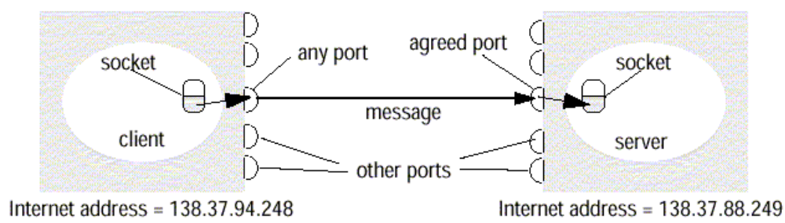
Sockets
Figure 2. Sockets and ports
VFSTR
Couloris,Dollimore and Kindberg Distributed Systems: Concepts & Design Edn. 4 , Pearson Education 2005

Slide 20
UDP Datagram Communication
UDP datagram properties No guarantee of order preservation Message loss and duplications are possible Necessary steps Creating a socket Binding a socket to a port and local Internet address A client binds to any free local port A server binds to a server port
VFSTR
Couloris,Dollimore and Kindberg Distributed Systems: Concepts & Design Edn. 4 , Pearson Education 2005

Slide 21
UDP Datagram Communication
Receive method It returns Internet address and port of sender, plus message.
VFSTR
Couloris,Dollimore and Kindberg Distributed Systems: Concepts & Design Edn. 4 , Pearson Education 2005

Slide 22
UDP Datagram Communication
Issues related to datagram communications are: Message size IP allows for messages of up to 216 bytes. Most implementations restrict this to around 8 kbytes. Any application requiring messages larger than the maximum must fragment. If arriving message is too big for array allocated to receive message content, truncation occurs.
VFSTR
Couloris,Dollimore and Kindberg Distributed Systems: Concepts & Design Edn. 4 , Pearson Education 2005

Slide 23
UDP Datagram Communication
Blocking Send: non-blocking upon arrival, message is placed in a queue for the socket that is bound to the destination port. Receive: blocking Pre-emption by timeout possible If process wishes to continue while waiting for packet, use separate thread
VFSTR
Couloris,Dollimore and Kindberg Distributed Systems: Concepts & Design Edn. 4 , Pearson Education 2005

Slide 24
UDP Datagram Communication
Timeout Receive from any
VFSTR
Couloris,Dollimore and Kindberg Distributed Systems: Concepts & Design Edn. 4 , Pearson Education 2005

Slide 25
UDP Datagram Communication
UDP datagrams suffer from following failures: Omission failure Messages may be dropped occasionally, Ordering
VFSTR
Couloris,Dollimore and Kindberg Distributed Systems: Concepts & Design Edn. 4 , Pearson Education 2005

Slide 26
Java API for UDP Datagrams
The Java API provides datagram communication by two classes: DatagramPacket It provides a constructor to make an array of bytes comprising: Message content Length of message Internet address Local port number It provides another similar constructor for receiving a message.
array of bytes containing message | length of message| Internet address | port number|
VFSTR
Couloris,Dollimore and Kindberg Distributed Systems: Concepts & Design Edn. 4 , Pearson Education 2005

Slide 27
Java API for UDP Datagrams
DatagramSocket This class supports sockets for sending and receiving UDP datagram. It provides a constructor with port number as argument. No-argument constructor is used to choose a free local port. DatagramSocket methods are: send and receive setSoTimeout connect
VFSTR
Couloris,Dollimore and Kindberg Distributed Systems: Concepts & Design Edn. 4 , Pearson Education 2005

Slide 28
Java API for UDP Datagrams
Example – The process creates a socket, sends a message to a server at port 6789 and waits to receive a reply. (Figure 3)
VFSTR
Couloris,Dollimore and Kindberg Distributed Systems: Concepts & Design Edn. 4 , Pearson Education 2005

Slide 29
Java API for UDP Datagrams
import java.net.*; import java.io.*; public class UDPClient{ public static void main(String args[]){ // args give message contents and destination hostname try { DatagramSocket aSocket = new DatagramSocket(); // create socket byte [] m = args[0].getBytes(); InetAddress aHost = InetAddress.getByName(args[1]); // DNS lookup int serverPort = 6789; DatagramPacket request = new DatagramPacket(m, args[0].length(), aHost, serverPort); aSocket.send(request); //send nessage byte[] buffer = new byte[1000]; DatagramPacket reply = new DatagramPacket(buffer, buffer.length); aSocket.receive(reply); //wait for reply System.out.println("Reply: " + new String(reply.getData())); aSocket.close(); }catch (SocketException e){System.out.println("Socket: " + e.getMessage()); }catch (IOException e){System.out.println("IO: " + e.getMessage());} } finally{if (aSocket !=null)aSocket.close()} } }
Figure 3. UDP client sends a message to the server and gets a reply
VFSTR
Couloris,Dollimore and Kindberg Distributed Systems: Concepts & Design Edn. 4 , Pearson Education 2005

Slide 30
Java API for UDP Datagrams
Example – The process creates a socket, bound to its server port 6789 and waits to receive a request message from a client. (Figure 4)
VFSTR
Couloris,Dollimore and Kindberg Distributed Systems: Concepts & Design Edn. 4 , Pearson Education 2005

Slide 31
Java API for UDP datagrams
import java.net.*; import java.io.*; public class UDPServer{ public static void main(String args[]){ DatagramSocket aSocket = null; try { aSocket = new DatagramSocket(6789); byte []buffer = new byte[1000]; While(true){ DatagramPacket request =new DatagramPacket(buffer, buffer.length); aSocket.receive(request); DatagramPacket reply = new DatagramPacket(request.getData(); request.getLength(),request.getAddress(), request.getPort(); aSocket.send(reply); } }catch (SocketException e){System.out.println("Socket: " + e.getMessage()); }catch (IOException e){System.out.println("IO: " + e.getMessage());} }finally{if (aSocket !=null)aSocket.close()} } }
Figure 4. UDP server repeatedly receives a request and sends it back to the client
VFSTR
Couloris,Dollimore and Kindberg Distributed Systems: Concepts & Design Edn. 4 , Pearson Education 2005

Slide 32
TCP Stream Communication
The API to the TCP protocol provides the abstraction of a stream of bytes to be written to or read from. Characteristics of the stream abstraction: Message sizes Lost messages Flow control Message destinations
VFSTR
Couloris,Dollimore and Kindberg Distributed Systems: Concepts & Design Edn. 4 , Pearson Education 2005

Slide 33
TCP Stream Communication
Issues related to stream communication: Matching of data items Blocking Threads
VFSTR
Couloris,Dollimore and Kindberg Distributed Systems: Concepts & Design Edn. 4 , Pearson Education 2005

Slide 34
TCP Stream Communication
Use of TCP Many services that run over TCP connections, with reserved port number are: HTTP (Hypertext Transfer Protocol) FTP (File Transfer Protocol) Telnet SMTP (Simple Mail Transfer Protocol)
VFSTR
Couloris,Dollimore and Kindberg Distributed Systems: Concepts & Design Edn. 4 , Pearson Education 2005

Slide 35
TCP Stream Communication
Java API for TCP streams The Java interface to TCP streams is provided in the classes: ServerSocket It is used by a server to create a socket at server port to listen for connect requests from clients. Socket It is used by a pair of processes with a connection. The client uses a constructor to create a socket and connect it to the remote host and port of a server. It provides methods for accessing input and output streams associated with a socket.
VFSTR
Couloris,Dollimore and Kindberg Distributed Systems: Concepts & Design Edn. 4 , Pearson Education 2005

Slide 36
Java API for UDP Datagrams
Example – The client process creates a socket, bound to the hostname and server port 6789. (Figure 5)
VFSTR
Couloris,Dollimore and Kindberg Distributed Systems: Concepts & Design Edn. 4 , Pearson Education 2005

Slide 37
Java API for UDP Datagrams
Example – The server process opens a server socket to its server port 6789 and listens for connect requests. (Figure 6,7)
VFSTR
Couloris,Dollimore and Kindberg Distributed Systems: Concepts & Design Edn. 4 , Pearson Education 2005

Slide 38
TCP Stream Communication
import java.net.*; import java.io.*; public class TCPServer { public static void main (String args[]) { try{ int serverPort = 7896; ServerSocket listenSocket = new ServerSocket(serverPort); while(true) { Socket clientSocket = listenSocket.accept(); Connection c = new Connection(clientSocket); } } catch(IOException e) {System.out.println("Listen socket:"+e.getMessage());} } }
Figure 6. TCP server makes a connection for each client and then echoes the client’s request
VFSTR
Couloris,Dollimore and Kindberg Distributed Systems: Concepts & Design Edn. 4 , Pearson Education 2005

Slide 39
TCP Stream Communication
class Connection extends Thread { DataInputStream in; DataOutputStream out; Socket clientSocket; public Connection (Socket aClientSocket) { try { clientSocket = aClientSocket; in = new DataInputStream( clientSocket.getInputStream()); out =new DataOutputStream( clientSocket.getOutputStream()); this.start(); } catch(IOException e){System.out.println("Connection:"+e.getMessage());} } public void run(){ try { // an echo server String data = in.readUTF(); out.writeUTF(data); } catch (EOFException e){System.out.println("EOF:"+e.getMessage()); } catch (IOException e) {System.out.println("readline:"+e.getMessage());} } finally {try{clientSocket.close();}catch(IOException e){/*close failed*/}} } }
Figure 7. TCP server makes a connection for each client and then echoes the client’s request
VFSTR
Couloris,Dollimore and Kindberg Distributed Systems: Concepts & Design Edn. 4 , Pearson Education 2005

Slide 40
External Data Representation
The information stored in running programs is represented as data structures, whereas the information in messages consists of sequences of bytes. Irrespective of the form of communication used, the data structure must be converted to a sequence of bytes before transmission and rebuilt on arrival.
VFSTR
Couloris,Dollimore and Kindberg Distributed Systems: Concepts & Design Edn. 4 , Pearson Education 2005

Slide 41
External Data Representation
External Data Representation is an agreed standard for the representation of data structures and primitive values. Data representation problems are: Using agreed external representation, two conversions necessary Using sender’s or receiver’s format and convert at the other end
VFSTR
Couloris,Dollimore and Kindberg Distributed Systems: Concepts & Design Edn. 4 , Pearson Education 2005

Slide 42
External Data Representation
Marshalling Marshalling is the process of taking a collection of data items and assembling them into a form suitable for transmission in a message. Unmarshalling Unmarshalling is the process of disassembling a collection of data on arrival to produce an equivalent collection of data items at the destination.
VFSTR
Couloris,Dollimore and Kindberg Distributed Systems: Concepts & Design Edn. 4 , Pearson Education 2005

Slide 43
External Data Representation
Three approaches to external data representation and marshalling are: CORBA Java’s object serialization XML
VFSTR
Couloris,Dollimore and Kindberg Distributed Systems: Concepts & Design Edn. 4 , Pearson Education 2005

Slide 44
External Data Representation
Marshalling and unmarshalling activities is usually performed automatically by middleware layer. Marshalling is likely error-prone if carried out by hand.
VFSTR
Couloris,Dollimore and Kindberg Distributed Systems: Concepts & Design Edn. 4 , Pearson Education 2005

Slide 45
CORBA Common Data Representation (CDR)
CORBA Common Data Representation (CDR) CORBA CDR is the external data representation defined with CORBA 2.0. It consists 15 primitive types: Short (16 bit) Long (32 bit) Unsigned short Unsigned long Float(32 bit) Double(64 bit) Char Boolean(TRUE,FALSE) Octet(8 bit) Any(can represent any basic or constructed type) Composite type are shown in Figure 8.
VFSTR
Couloris,Dollimore and Kindberg Distributed Systems: Concepts & Design Edn. 4 , Pearson Education 2005

Slide 46
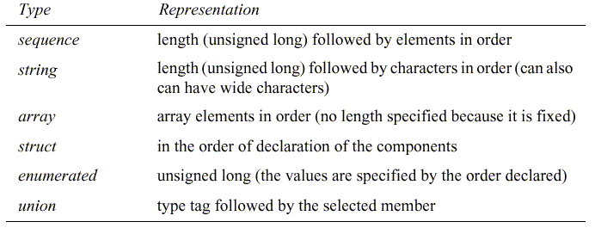
CORBA Common Data Representation (CDR)
Figure 8. CORBA CDR for constructed types
VFSTR
Couloris,Dollimore and Kindberg Distributed Systems: Concepts & Design Edn. 4 , Pearson Education 2005

Slide 47
CORBA Common Data Representation (CDR)
Constructed types: The primitive values that comprise each constructed type are added to a sequence of bytes in a particular order, as shown in Figure 8.
VFSTR
Couloris,Dollimore and Kindberg Distributed Systems: Concepts & Design Edn. 4 , Pearson Education 2005

Slide 48
CORBA Common Data Representation (CDR)
Figure 9 shows a message in CORBA CDR that contains the three fields of a struct whose respective types are string, string, and unsigned long.
VFSTR
Couloris,Dollimore and Kindberg Distributed Systems: Concepts & Design Edn. 4 , Pearson Education 2005

Slide 49
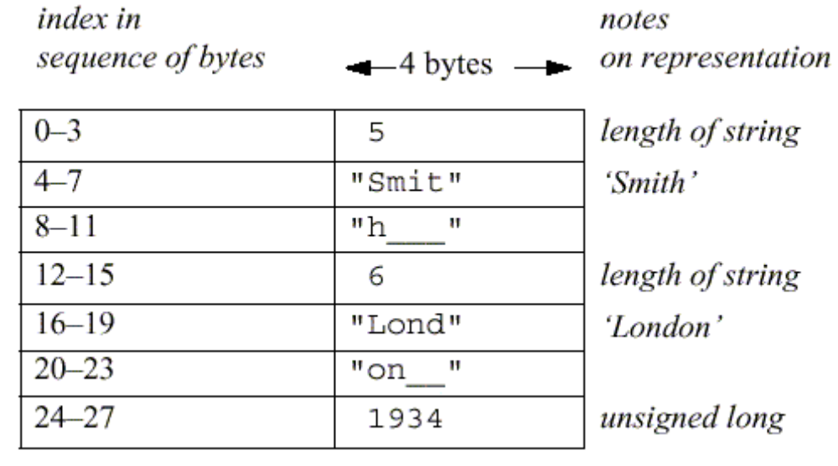
CORBA Common Data Representation (CDR)
example: struct with value {‘Smith’, ‘London’, 1934}
Figure 9. CORBA CDR message
VFSTR
Couloris,Dollimore and Kindberg Distributed Systems: Concepts & Design Edn. 4 , Pearson Education 2005

Slide 50
Java object serialization
In Java RMI, both object and primitive data values may be passed as arguments and results of method invocation. An object is an instance of a Java class. Example, the Java class equivalent to the Person struct Public class Person implements Serializable { Private String name; Private String place; Private int year; Public Person(String aName ,String aPlace, int aYear) { name = aName; place = aPlace; year = aYear; } //followed by methods for accessing the instance variables }
VFSTR
Couloris,Dollimore and Kindberg Distributed Systems: Concepts & Design Edn. 4 , Pearson Education 2005

Slide 51
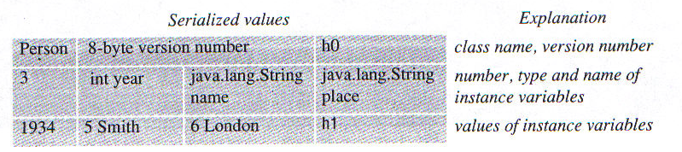
Java object serialization
The serialized form is illustrated in Figure 10.
Figure 10. Indication of Java serialization form
VFSTR
Couloris,Dollimore and Kindberg Distributed Systems: Concepts & Design Edn. 4 , Pearson Education 2005

Slide 52
Remote Object References
Remote object references are needed when a client invokes an object that is located on a remote server. A remote object reference is passed in the invocation message to specify which object is to be invoked. Remote object references must be unique over space and time.
VFSTR
Couloris,Dollimore and Kindberg Distributed Systems: Concepts & Design Edn. 4 , Pearson Education 2005

Slide 53
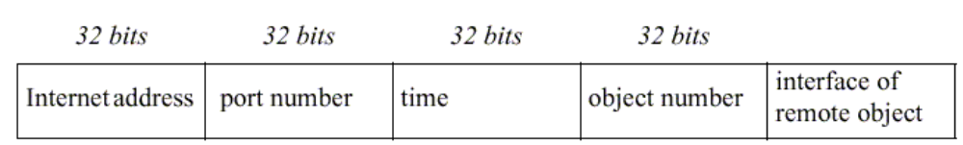
Remote Object References
In general, may be many processes hosting remote objects, so remote object referencing must be unique among all of the processes in the various computers in a distributed system. generic format for remote object references is shown in Figure 11.
Figure 11. Representation of a remote object references
VFSTR
Couloris,Dollimore and Kindberg Distributed Systems: Concepts & Design Edn. 4 , Pearson Education 2005

Slide 54
Remote Object References
internet address/port number: process which created object time: creation time object number: local counter, incremented each time an object is created in the creating process interface: how to access the remote object (if object reference is passed from one client to another)
VFSTR
Couloris,Dollimore and Kindberg Distributed Systems: Concepts & Design Edn. 4 , Pearson Education 2005

Slide 55
Client-Server Communication
The client-server communication is designed to support the roles and message exchanges in typical client-server interactions. In the normal case, request-reply communication is synchronous because the client process blocks until the reply arrives from the server. Asynchronous request-reply communication is an alternative that is useful where clients can afford to retrieve replies later.
VFSTR
Couloris,Dollimore and Kindberg Distributed Systems: Concepts & Design Edn. 4 , Pearson Education 2005

Slide 56
Client-Server Communication
Often built over UDP datagrams Client-server protocol consists of request/response pairs, hence no acknowledgements at transport layer are necessary Avoidance of connection establishment overhead No need for flow control due to small amounts of data are transferred
VFSTR
Couloris,Dollimore and Kindberg Distributed Systems: Concepts & Design Edn. 4 , Pearson Education 2005

Slide 57
Client-Server Communication
The request-reply protocol was based on a trio of communication primitives: doOperation, getRequest, and sendReply shown in Figure 12.
VFSTR
Couloris,Dollimore and Kindberg Distributed Systems: Concepts & Design Edn. 4 , Pearson Education 2005

Slide 58
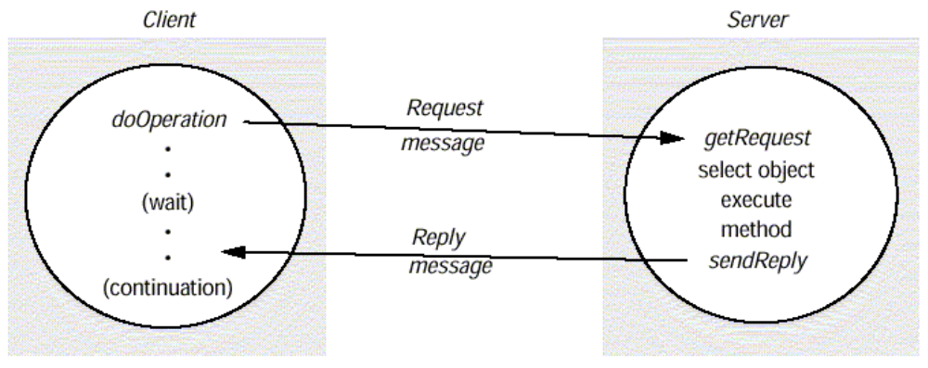
Client-Server Communication
The request-reply protocol is shown in Figure 12.
Figure 12. Request-reply communication
VFSTR
Couloris,Dollimore and Kindberg Distributed Systems: Concepts & Design Edn. 4 , Pearson Education 2005

Slide 59
Client-Server Communication
The designed request-reply protocol matches requests to replies. If UDP datagrams are used, the delivery guarantees must be provided by the request-reply protocol, which may use the server reply message as an acknowledgement of the client request message. Figure 13 outlines the three communication primitives.
VFSTR
Couloris,Dollimore and Kindberg Distributed Systems: Concepts & Design Edn. 4 , Pearson Education 2005

Slide 60
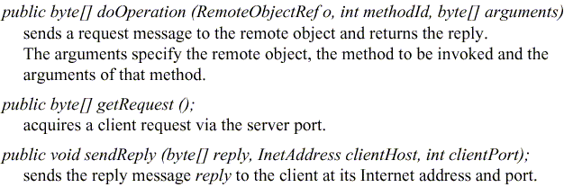
Client-Server Communication
Figure 13. Operations of the request-reply protocol
VFSTR
Couloris,Dollimore and Kindberg Distributed Systems: Concepts & Design Edn. 4 , Pearson Education 2005

Slide 61
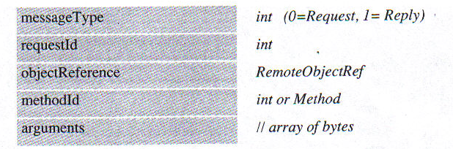
Client-Server Communication
The information to be transmitted in a request message or a reply message is shown in Figure 14.
Figure 14. Request-reply message structure
VFSTR
Couloris,Dollimore and Kindberg Distributed Systems: Concepts & Design Edn. 4 , Pearson Education 2005

Slide 62
Client-Server Communication
In a protocol message The first field indicates whether the message is a request or a reply message. The second field request id contains a message identifier. The third field is a remote object reference . The forth field is an identifier for the method to be invoked.
VFSTR
Couloris,Dollimore and Kindberg Distributed Systems: Concepts & Design Edn. 4 , Pearson Education 2005

Slide 63
Client-Server Communication
Message identifier A message identifier consists of two parts: A requestId, which is taken from an increasing sequence of integers by the sending process An identifier for the sender process, for example its port and Internet address.
VFSTR
Couloris,Dollimore and Kindberg Distributed Systems: Concepts & Design Edn. 4 , Pearson Education 2005

Slide 64
Client-Server Communication
Failure model of the request-reply protocol If the three primitive doOperation, getRequest, and sendReply are implemented over UDP datagram, they have the same communication failures. Omission failure Messages are not guaranteed to be delivered in sender order.
VFSTR
Couloris,Dollimore and Kindberg Distributed Systems: Concepts & Design Edn. 4 , Pearson Education 2005

Slide 65
Client-Server Communication
RPC exchange protocols Three protocols are used for implementing various types of RPC. The request (R) protocol. The request-reply (RR) protocol. The request-reply-acknowledge (RRA) protocol. (Figure 15)
VFSTR
Couloris,Dollimore and Kindberg Distributed Systems: Concepts & Design Edn. 4 , Pearson Education 2005

Slide 66
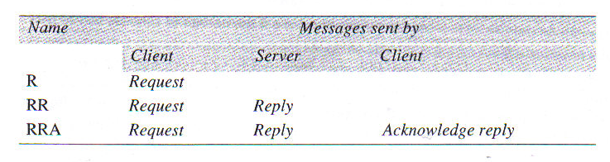
Client-Server Communication
Figure 15. RPC exchange protocols
VFSTR
Couloris,Dollimore and Kindberg Distributed Systems: Concepts & Design Edn. 4 , Pearson Education 2005

Slide 67
Client-Server Communication
In the R protocol, a single request message is sent by the client to the server. The R protocol may be used when there is no value to be returned from the remote method. The RR protocol is useful for most client-server exchanges because it is based on request-reply protocol. RRA protocol is based on the exchange of three messages: request-reply-acknowledge reply.
VFSTR
Couloris,Dollimore and Kindberg Distributed Systems: Concepts & Design Edn. 4 , Pearson Education 2005

Slide 68
Client-Server Communication
HTTP: an example of a request-reply protocol HTTP is a request-reply protocol for the exchange of network resources between web clients and web servers.
VFSTR
Couloris,Dollimore and Kindberg Distributed Systems: Concepts & Design Edn. 4 , Pearson Education 2005

Slide 69
Client-Server Communication
HTTP protocol steps are: Connection establishment between client and server at the default server port or at a port specified in the URL client sends a request server sends a reply connection closure
VFSTR
Couloris,Dollimore and Kindberg Distributed Systems: Concepts & Design Edn. 4 , Pearson Education 2005

Slide 70
Client-Server Communication
HTTP 1.1 uses persistent connections. Persistent connections are connections that remains open over a series of request-reply exchanges between client and server. Resources can have MIME-like structures in arguments and results.
VFSTR
Couloris,Dollimore and Kindberg Distributed Systems: Concepts & Design Edn. 4 , Pearson Education 2005

Slide 71
Client-Server Communication
A Mime type specifies a type and a subtype, for example: text/plain text/html image/gif image/jpeg
VFSTR
Couloris,Dollimore and Kindberg Distributed Systems: Concepts & Design Edn. 4 , Pearson Education 2005

Slide 72
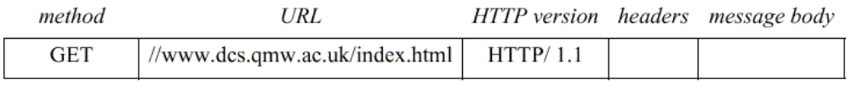
Client-Server Communication
HTTP methods GET Requests the resource, identified by URL as argument. If the URL refers to data, then the web server replies by returning the data If the URL refers to a program, then the web server runs the program and returns the output to the client.
Figure 16. HTTP request message
VFSTR
Couloris,Dollimore and Kindberg Distributed Systems: Concepts & Design Edn. 4 , Pearson Education 2005

Slide 73
Client-Server Communication
HEAD This method is similar to GET, but only meta data on resource is returned (like date of last modification, type, and size)
VFSTR
Couloris,Dollimore and Kindberg Distributed Systems: Concepts & Design Edn. 4 , Pearson Education 2005

Slide 74
Client-Server Communication
POST Specifies the URL of a resource (for instance, a server program) that can deal with the data supplied with the request. This method is designed to deal with: Providing a block of data to a data-handling process Posting a message to a bulletin board, mailing list or news group. Extending a dataset with an append operation
VFSTR
Couloris,Dollimore and Kindberg Distributed Systems: Concepts & Design Edn. 4 , Pearson Education 2005

Slide 75
Client-Server Communication
PUT Supplied data to be stored in the given URL as its identifier. DELETE The server deletes an identified resource by the given URL on the server. OPTIONS A server supplies the client with a list of methods. It allows to be applied to the given URL
VFSTR
Couloris,Dollimore and Kindberg Distributed Systems: Concepts & Design Edn. 4 , Pearson Education 2005

Slide 76
Client-Server Communication
TRACE The server sends back the request message
VFSTR
Couloris,Dollimore and Kindberg Distributed Systems: Concepts & Design Edn. 4 , Pearson Education 2005

Slide 77
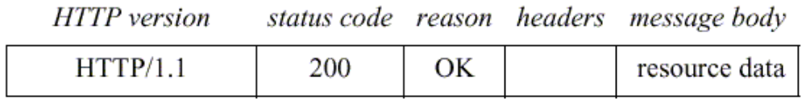
Client-Server Communication
A reply message specifies The protocol version A status code Reason Some headers An optional message body
Figure 17. HTTP reply message
VFSTR
Couloris,Dollimore and Kindberg Distributed Systems: Concepts & Design Edn. 4 , Pearson Education 2005

Slide 78
Group Communication
The pairwise exchange of messages is not the best model for communication from one process to a group of other processes. A multicast operation is more appropriate. Multicast operation is an operation that sends a single message from one process to each of the members of a group of processes.
VFSTR
Couloris,Dollimore and Kindberg Distributed Systems: Concepts & Design Edn. 4 , Pearson Education 2005

Slide 79
Group Communication
The simplest way of multicasting, provides no guarantees about message delivery or ordering. Multicasting has the following characteristics: Fault tolerance based on replicated services A replicated service consists of a group of servers.
VFSTR
Couloris,Dollimore and Kindberg Distributed Systems: Concepts & Design Edn. 4 , Pearson Education 2005

Slide 80
Group Communication
Client requests are multicast to all the members of the group, each of which performs an identical operation. Finding the discovery servers in spontaneous networking Multicast messages can be used by servers and clients to locate available discovery services in order to register their interfaces or to look up the interfaces of other services in the distributed system.
VFSTR
Couloris,Dollimore and Kindberg Distributed Systems: Concepts & Design Edn. 4 , Pearson Education 2005

Slide 81
Group Communication
Better performance through replicated data Data are replicated to increase the performance of a service. Propagation of event notifications Multicast to a group may be used to notify processes when something happens.
VFSTR
Couloris,Dollimore and Kindberg Distributed Systems: Concepts & Design Edn. 4 , Pearson Education 2005

Slide 82
Group Communication
IP multicast IP multicast is built on top of the Internet protocol, IP. IP multicast allows the sender to transmit a single IP packet to a multicast group. A multicast group is specified by class D IP address for which first 4 bits are 1110 in IPv4.
VFSTR
Couloris,Dollimore and Kindberg Distributed Systems: Concepts & Design Edn. 4 , Pearson Education 2005

Slide 83
Group Communication
The membership of a multicast group is dynamic. A computer belongs to a multicast group if one or more processes have sockets that belong to the multicast group.
VFSTR
Couloris,Dollimore and Kindberg Distributed Systems: Concepts & Design Edn. 4 , Pearson Education 2005

Slide 84
Group Communication
The following details are specific to IPv4: Multicast IP routers IP packets can be multicast both on local network and on the wider Internet. Local multicast uses local network such as Ethernet. To limit the distance of propagation of a multicast datagram, the sender can specify the number of routers it is allowed to pass- called the time to live, or TTL for short.
VFSTR
Couloris,Dollimore and Kindberg Distributed Systems: Concepts & Design Edn. 4 , Pearson Education 2005

Slide 85
Group Communication
Multicast address allocation Multicast addressing may be permanent or temporary. Permanent groups exist even when there are no members. Multicast addressing by temporary groups must be created before use and cease to exit when all members have left. The session directory (sd) program can be used to start or join a multicast session. session directory provides a tool with an interactive interface that allows users to browse advertised multicast sessions and to advertise their own session, specifying the time and duration.
VFSTR
Couloris,Dollimore and Kindberg Distributed Systems: Concepts & Design Edn. 4 , Pearson Education 2005

Slide 86
Group Communication
Java API to IP multicast The Java API provides a datagram interface to IP multicast through the class MulticastSocket, which is a subset of DatagramSocket with the additional capability of being able to join multicast groups. The class MulticastSocket provides two alternative constructors , allowing socket to be creative to use either a specified local port, or any free local port. (Figure 18)
VFSTR
Couloris,Dollimore and Kindberg Distributed Systems: Concepts & Design Edn. 4 , Pearson Education 2005

Slide 87
Group Communication
import java.net.*; import java.io.*; public class MulticastPeer{ public static void main(String args[]){ // args give message contents and destination multicast group (e.g. "228.5.6.7") MulticastSocket s =null; try { InetAddress group = InetAddress.getByName(args[1]); s = new MulticastSocket(6789); s.joinGroup(group); byte [] m = args[0].getBytes(); DatagramPacket messageOut = new DatagramPacket(m, m.length, group, 6789); s.send(messageOut); byte[] buffer = new byte[1000]; for(int i=0; i< 3;i++) { // get messages from others in group DatagramPacket messageIn = new DatagramPacket(buffer, buffer.length); s.receive(messageIn); System.out.println("Received:" + new String(messageIn.getData())); } s.leaveGroup(group); }catch (SocketException e){System.out.println("Socket: " + e.getMessage()); }catch (IOException e){System.out.println("IO: " + e.getMessage()); }finally {if(s != null) s.close();} } }
Figure 18. Multicast peer joins a group and sends and receives datagrams
VFSTR
Couloris,Dollimore and Kindberg Distributed Systems: Concepts & Design Edn. 4 , Pearson Education 2005

Slide 88
Group Communication
A process can join a multicast group with a given multicast address by invoking the joinGroup method of its multicast socket. A process can leave a specified group by invoking the leaveGroup method of its multicast socket. The Java API allows the TTL to be set for a multicast socket by means of the setTimeToLive method. The default is 1, allowing the multicast to propagate only on the local network.
VFSTR
Couloris,Dollimore and Kindberg Distributed Systems: Concepts & Design Edn. 4 , Pearson Education 2005

